Slide 1

Anticipating Customer Churn in Telecommunication using Machine Learning Algorithms for Customer Retention
SRM INSTITUTE OF SCIENCE AND TECHNOLOGY
SCHOOL OF COMPUTING
DEPARTMENT OF COMPUTING TECHNOLOGIES
18CSP107L / 18CSP108L - MINOR PROJECT
GUIDE NAME:
Dr. S. Priya
Assistant Professor
Department of Computing Technologies
Batch ID: B314
Student Reg. No: RA2011003010511
Student Name: K. RAJARAJAN
Student Reg. No: RA2011003010501
Student Name: D.VISHAL REDDY

Slide 2
Abstract
Customer attrition is a significant issue and a top priority for large corporations. This study addresses this pressing issue. The dataset is obtained from Kaggle which constitutes of training set and testing set, 80 percent and 20 percent of the entire dataset respectively for identifying customers who tend to unsubscribe in the telecommunications industry. Predicting customer churn with precision is a difficult endeavor, mostly due to the dependence on a singular prediction model in most existing projects.
To address this, this study proposes a novel approach that compares multiple prediction models like logistic regression, KNN, random forest, SVV, Gaussian NB, Kernel SVM, Support Vector Machine, to estimate customer churn. With ROC AUC Mean score of 84% for Logistic Regression produced a better result. In the future, the study might be expanded to investigate the evolving behavioral patterns of churn consumers with the application of Artificial Intelligence approaches for predictive and trend analysis to preserve valuable client.

Slide 3
Abstract
Customer turnover is a serious problem and one of the main concerns for big firms. Companies are working to develop methods for anticipating likely customer churn due to the direct impact on firms' earnings, particularly in the telecoms sector.
Therefore, knowing the factors that lead to client churn is essential to taking the necessary action to lower it. The main objective is to create a churn prediction model that allows telecom operators to predict which customers are most likely to leave.

Slide 4
Introduction
Churn prediction means detecting which customers are likely to leave a service or to cancel a subscription to a service. It is a critical prediction for many businesses because acquiring new clients often costs more than retaining existing ones.
Some of the challenges are : Identify the customers who are at the risk of cancelling and to take marketing action for each individual customer to maximize their chance of retention.
Different customers exhibit different behaviours and preferences, so they cancel their subscriptions for various reasons. It is critical, therefore, to proactively communicate with each of them in order to retain them in your customer list.

Slide 5
Introduction
The percentage of customers who end their commercial relationship with a company over time is known as customer churn, also known as customer attrition. This can happen for a number of reasons, such as changes in the customer’s needs, receiving a better offer from a competitor, or unhappiness with the product or service.
Customer attrition is a significant issue and a top priority for large corporations. Companies, particularly in the telecom industry, are actively researching ways to predict client turnover in order to mitigate its impact on their revenues. Preventing customer attrition and retaining their client base has now become a crucial problem for corporate operations and growth. Identifying and resolving customer churn is crucial, as it has a substantial impact on a company’s financial performance.

Slide 6
Introduction
When clients terminate their commercial association with a company, it not only diminishes revenue but also escalates the expenses incurred in attracting new customers to fill their place. Moreover, comprehending the underlying causes of customer attrition can aid the organization in improving its offerings, services, and overall customer satisfaction.
The user’s text is empty. By identifying these problems, the decrease in customer attrition can result in many advantages, such as enhanced client allegiance, heightened customer lifetime value, favourable oral message promotion, and a competitive border. One significant method that can help with both forecasting and reducing client attrition is machine learning.

Slide 7
Introduction
Machine learning techniques that analyse historical data and identify patterns that indicate which customers are more likely to leave, such as logistic regression, decision trees, random forests, and neural networks, can be used to forecast customer churn.
After identifying these vulnerable customers, companies can employ tactics such as providing exclusive incentives or discounts to ensure their loyalty. Moreover, machine learning has the capability to identify the precise elements that lead to customer churn, such as price issues, customer service issues, or superior products, by looking at behavioural data and customer reviews. Machine learning is an effective way for businesses to increase sales, lower attrition, improve customer retention, and increase profitability.

Slide 8
Literature Review
 | Reference Paper [1] [2023]
Authors | Nyoman Mahayasa Adiputra, Paweena Wanchai
Paper Title | Customer Churn Prediction Using Weight Average Ensemble Machine Learning Model
Journal Name / Conference Name | 2023 20th International Joint Conference on Computer Science and Software Engineering (JCSSE)
Methodology/ Techniques/ Algorithms Used | This paper utilizes a weight average ensemble method that combines multiple machine learning models to improve the accuracy and reliability of customer churn predictions. The ensemble model integrates the strengths of individual models to achieve better performance
Dataset used | Kaggle
Merits | The ensemble model approach enhances prediction accuracy and robustness by leveraging the collective strengths of various algorithms. This method helps in reducing the bias and variance associated with single-model predictions, leading to more reliable churn forecasts.
Demerits | Ensemble models can be computationally more intensive and complex to implement than single models. The improvement in accuracy might come at the cost of increased complexity and computational resources required for model training and predictions.

Slide 9
Literature Review
 | Reference Paper [2] [2023]
Authors | Diaa Azzam, Manar Hamed, Nora Kasiem, Yomna Eid, Walaa Medhat
Paper Title | Customer Churn Prediction Using Apriori Algorithm and Ensemble Learning
Journal Name / Conference Name | 2023 5th Novel Intelligent and Leading Emerging Sciences Conference (NILES)
Methodology/ Techniques/ Algorithms Used | The study explores the use of the Apriori algorithm in conjunction with ensemble learning techniques to predict customer churn. This innovative approach combines the strengths of association rule mining provided by the Apriori algorithm with the robust predictive capabilities of ensemble learning models to enhance churn prediction accuracy.
Dataset used | IBM Watson telcocustomer Chrun Dataset
Merits | By integrating the Apriori algorithm with ensemble learning, the proposed method effectively identifies underlying patterns and associations within the data that are indicative of churn. This dual approach not only improves prediction accuracy but also offers insights into the factors contributing to customer churn, enabling targeted retention strategies.
Demerits | The combination of the Apriori algorithm and ensemble learning models may lead to increased computational complexity and longer processing times compared to simpler predictive models. Additionally, the effectiveness of this approach may be contingent on the quality and completeness of the dataset used for training.

Slide 10
Literature Review
 | Reference Paper [3] [2022]
Authors | Yunjie Lin, Mu Shengdong, Gu jijian, Nadia Nedjah
Paper Title | Intelligent prediction using customer churn with a Fused attentional Deep learning model
Journal Name / Conference Name | 2022 Multidisciplinary Digital Publishing Institute (MDPI), China
Methodology/ Techniques/ Algorithms Used | The paper presents a novel deep learning approach that incorporates a fused attention mechanism for customer churn prediction. This model leverages the strengths of bi-directional long short-term memory (Bi-LSTM) and convolutional neural networks (CNNs) with an attention mechanism to enhance the predictive accuracy by focusing on significant features within the data.
Dataset used | Kaggle
Merits | The introduction of the attention mechanism allows for the model to dynamically focus on relevant data features, potentially leading to higher predictive accuracy and better understanding of churn-inducing factors. This could enable businesses to target their retention strategies more effectively
Demerits | Despite its advantages, the complexity of implementing a fused attentional deep learning model might be a barrier for some organizations. Additionally, the computational resources required for training and deploying this model could be significant, potentially limiting its accessibility to companies with fewer technical capabilities.

Slide 11
Literature Review
 | Reference Paper [4] [2023]
Authors | Parth Pulkundwar, Krishna Rudani, Omkar Rane, Chintan Shah, Shyamal Virnodkar
Paper Title | A Comparison of Machine Learning Algorithms for Customer Churn Prediction
Journal Name / Conference Name | 2023 6th International Conference on Advances in Science and Technology (ICAST)
Methodology/ Techniques/ Algorithms Used | This research paper undertakes a comparative analysis of various machine learning algorithms to identify the most effective approach for predicting customer churn. It examines the performance of several models, including decision trees, support vector machines (SVM), neural networks, and random forests, in terms of their accuracy, precision, recall, and F1 score metrics.
Dataset used | UCI Machine learning Repository
Merits | The comprehensive comparison provides valuable insights into the strengths and weaknesses of each algorithm in the context of churn prediction, offering a guide for businesses to choose the most suitable model based on their specific data characteristics and business requirements.
Demerits | While the comparative approach is informative, the effectiveness of each algorithm can greatly depend on the specifics of the dataset used, including its size, quality, and the nature of the features. This means that the best-performing algorithm in one scenario may not necessarily be the best in another, limiting the generalizability of the findings.

Slide 12
Literature Review
 | Reference Paper [5] [2020]
Authors | Eunjo Lee, Boram Kim, Sungwook Kang, Byungsoo Kang, Yoonjae Jang, and Huy Kang Kim
Paper Title | Profit Optimizing Churn Prediction For Long Term Loyal Customers in Online Games
Journal Name / Conference Name | 2020 IEEE Transactions on Games
Methodology/ Techniques/ Algorithms Used | This study introduces a novel churn prediction model specifically designed for the online gaming industry. It focuses on long-term loyal customers, applying machine learning techniques to predict churn based on in-game behaviors and transaction histories. The model aims to optimize profits by identifying the risk of churn among valuable players early and suggesting targeted interventions.
Dataset used | Local dataset
Merits | Tailoring churn prediction models to the nuances of online gaming customer behavior allows for more accurate predictions and targeted retention strategies, potentially increasing player lifetime value and overall profitability for game developers and publishers.
Demerits | The specialized focus on long-term loyal customers in the online gaming sector may limit the model's applicability to other industries or customer segments. Additionally, the success of the proposed interventions relies heavily on the quality and depth of the available data, which may not be uniformly high across different gaming platforms.

Slide 13
Literature Review
 | Reference Paper [6] [2020]
Authors | Xin Hu, Yanfei Yang, Lanhua Chen, Siru Zhu
Paper Title | Research on a customer Churn Combination Prediction Model Based on Decision Tree and Neural Network
Journal Name / Conference Name | 2020 IEEE 5th International Conference on Cloud Computing and Big Data Analytics (ICCCBDA)
Methodology/ Techniques/ Algorithms Used | This paper proposes a combined prediction model that integrates decision tree algorithms with neural networks to predict customer churn. This hybrid approach leverages the decision tree's ability to handle categorical data and the neural network's capability for pattern recognition and non-linear problem solving, aiming to enhance the predictive accuracy of customer churn.
Dataset used | MMORPG Aion dataset
Merits | The combined model approach aims to improve prediction accuracy by utilizing the strengths of both decision trees and neural networks. This method provides a more nuanced analysis of customer data, potentially leading to better-targeted retention strategies.
Demerits | The complexity of developing and tuning a hybrid model that includes both decision trees and neural networks can be significantly higher than using a single model approach. This may require more sophisticated data preprocessing and model optimization efforts, potentially limiting its applicability for organizations with limited data science resources.

Slide 14
Literature Review
 | Reference Paper [7] [2023]
Authors | Harish A S, Malathy C
Paper Title | Evaluative study of cluster based customer churn prediction against conventional RFM based churn model
Journal Name / Conference Name | 2023 Second International Conference on Electrical, Electronics, Information and Communication Technologies (ICEEICT)
Methodology/ Techniques/ Algorithms Used | This study conducts a comparative analysis between a novel cluster-based customer churn prediction model and the traditional Recency, Frequency, Monetary (RFM) based churn prediction model. The cluster-based approach utilizes machine learning techniques to group customers into clusters based on behavior patterns before applying churn prediction, aiming to identify nuanced behaviors that indicate churn risk.
Dataset used | Customer information of a super market from June 2018 to April 2019
Merits | The cluster-based model offers a more granular analysis of customer behavior by identifying distinct groups within the customer base. This can potentially lead to more accurate and targeted churn prediction, allowing businesses to tailor their retention strategies more effectively to different customer segments.
Demerits | The complexity of implementing a cluster-based model, from data preprocessing to cluster identification and analysis, can be significantly higher than that of conventional RFM models. Additionally, the effectiveness of the cluster-based approach may depend heavily on the quality and granularity of the available data, which could limit its applicability in scenarios with sparse or incomplete datasets.

Slide 15
Literature Review
 | Reference Paper [8] [2021]
Authors | Kiran Deep Singh, Prabh Deep Singh, Ankit Bansal, Gaganpreet Kaur, Vikas Khullar, Vikas Tripathi
Paper Title | Exploratory Data Analysis and Customer Churn Prediction for the Telecommunication Industry
Journal Name / Conference Name | 2023 3rd International Conference on Advances in Computing, Communication, Embedded and Secure Systems (ACCESS)
Methodology/ Techniques/ Algorithms Used | This paper emphasizes the importance of exploratory data analysis (EDA) in the early stages of predictive modeling for customer churn in the telecommunications sector. It details a comprehensive approach to EDA, utilizing statistical techniques and visualization tools to understand customer behavior patterns. Following the EDA, the study applies various machine learning models to predict churn, comparing their effectiveness in accurately identifying at-risk customers.
Dataset used | Local Dataset
Merits | The thorough EDA process allows for a deeper understanding of the factors influencing customer churn, enabling the development of more accurate predictive models. By comparing different machine learning algorithms, the study provides insights into which models are most effective for churn prediction in the telecommunications industry.
Demerits | The study's focus on the telecommunications sector may limit the applicability of its findings to other industries with different customer dynamics and churn factors. Additionally, the success of the predictive models depends on the quality and comprehensiveness of the dataset used, which may vary across different telecommunications providers.

Slide 16
Literature Review
 | Reference Paper [9] [2023]
Authors | Mustafa Büyükkeçeci, Mehmet Cudi Okur
Paper Title | A Data Mining Application in Customer Churn Predictio
Journal Name / Conference Name | 2022 IEEE Conference
Methodology/ Techniques/ Algorithms Used | The study presents a data mining approach to predict customer churn, utilizing a variety of algorithms to analyze customer behavior and identify potential churners. The methodologies include clustering, decision trees, and neural networks, among others, to process and analyze large datasets, aiming to uncover patterns and correlations related to churn..
Dataset used | Kaggle
Merits | This approach allows for a comprehensive analysis of customer data, leveraging the strengths of multiple data mining techniques to improve prediction accuracy. It provides valuable insights into customer behavior and the factors influencing churn, which can inform more effective customer retention strategies.
Demerits | The application of multiple data mining techniques may increase the complexity of the analysis and require significant computational resources. Additionally, the effectiveness of the model may be limited by the quality and completeness of the dataset, which can vary widely across different organizations or industries.

Slide 17
Literature Review
 | Reference Paper [10] [2020]
Authors | S. Venkatesh, M. Jeyakarthic
Paper Title | An Optimal Genetic Algorithm with Support Vector Machine for Cloud Based Customer Churn Prediction
Journal Name / Conference Name | 2020 IEEE Conference
Methodology/ Techniques/ Algorithms Used | This study introduces an innovative approach to churn prediction by integrating genetic algorithms with support vector machines (SVM) in a cloud computing environment. The genetic algorithm is used to optimize the parameters of the SVM, aiming to enhance the prediction accuracy of customer churn. This hybrid method seeks to leverage the scalability and computational power of cloud environments to process large datasets efficiently.
Dataset used | MMORPG Aion dataset
Merits | By optimizing SVM parameters using genetic algorithms, the model achieves higher accuracy and efficiency in churn prediction. The cloud-based deployment allows for scalable and cost-effective processing of large datasets, making it a viable solution for businesses of various sizes.
Demerits | The complexity of implementing and tuning a hybrid genetic algorithm and SVM model can be significant, potentially requiring specialized expertise. Additionally, the reliance on cloud infrastructure introduces concerns related to data security and privacy, which must be addressed.

Slide 18
Literature Review
 | Reference Paper [11] [2023]
Authors | Aishwarya H M, Bindhiya T, S Tanisha, Soundarya B, C Christlin Shanuja
Paper Title | Customer Churn Prediction Using Synthetic Minority Oversampling Technique
Journal Name / Conference Name | 2023 4th International Conference on Communication, Computing and Industry 6.0 (C2I6)
Methodology/ Techniques/ Algorithms Used | This paper focuses on addressing the imbalance in customer churn datasets by applying the Synthetic Minority Oversampling Technique (SMOTE). The approach enhances the predictive performance of churn models by balancing the dataset, thus improving the model's ability to identify churn-prone customers accurately. The study evaluates the effectiveness of this technique in conjunction with various machine learning algorithms to predict customer churn.
Dataset used | Kaggle
Merits | The use of SMOTE to balance the dataset can significantly improve the model's sensitivity to churn-prone customers, which is particularly valuable in datasets where churn instances are much rarer than non-churn instances. This method can lead to more effective and equitable prediction outcomes.
Demerits | While SMOTE can improve the detection of minority class instances, it may also introduce synthetic noise into the dataset, potentially leading to overfitting. The effectiveness of this approach heavily depends on the quality of the dataset and the specific machine learning algorithms used in conjunction with SMOTE.

Slide 19
Existing System
The method used today to use machine learning to forecast customer attrition may vary depending on the business, the industry, and the data at hand. However, in general, companies may employ a traditional approach to churn prediction, which entails manual data analysis, a small number of variables, and elementary statistical models.
This approach might not be accurate or efficient, which could lead to poor business decisions and customer retention strategies.
Some organizations may already be using a basic machine learning model that was trained on sparse and outdated data, and has a predetermined set of characteristics. This approach's inability to account for dynamic shifts in customer behavior and preferences may lead to less accurate forecasts.

Slide 20
Limitation of Existing System
Organizations have a traditional approach to churn prediction.
Involves manual data analysis, poor system architecture.
Lack of training data and old datasets
Simple statistical models.
Lack accuracy and efficiency
Finding out features contributing towards customer churn.

Slide 21
OBJECTIVES
To preprocess the available customer data, including demographic information, transaction history, customer interactions, and engagement metrics to ensure the quality of input data.
To select the right features from the preprocessed input data using the machine learning model.
To build a predictive model, that analyze historical customer data and behavior to identify patterns indicative of potential churn using the machine learning algorithms to classify customers into churn and non-churn categories.

Slide 22
PROPOSED WORKFLOW
Exploratory data Analysis
Cleaned Data
Data set
Step:1 Data preprocessing and cleaning
Step:2
Feature selection
Step:3
Data Cleaning and preprocessing
Step:4 deploy the model
Logistic regression
Decision tree
Random Forest

Slide 23
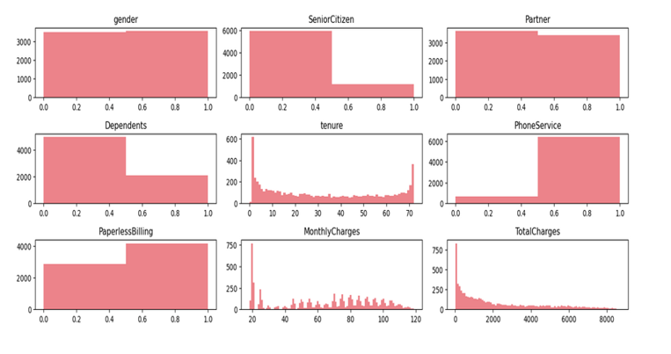
Exploratory Data Analysis

Slide 24
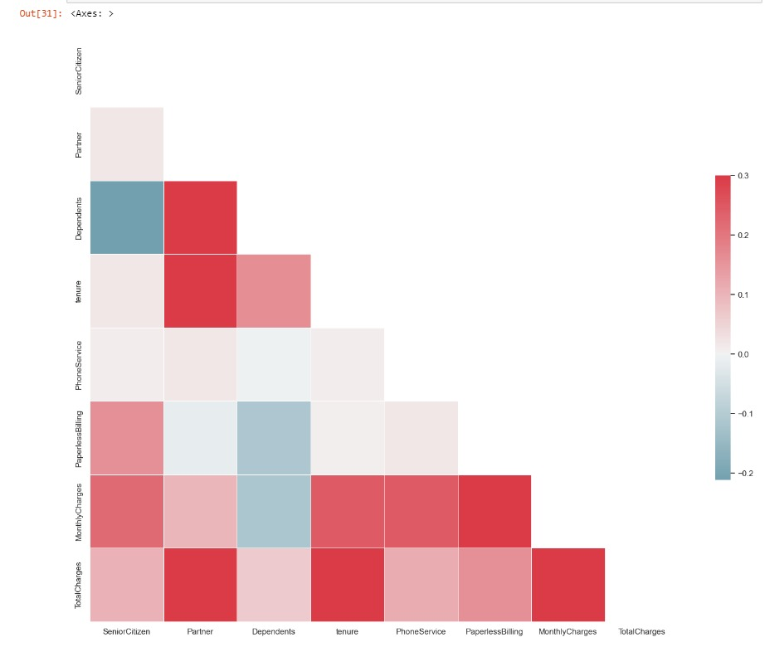
Correlation Matrix

Slide 25
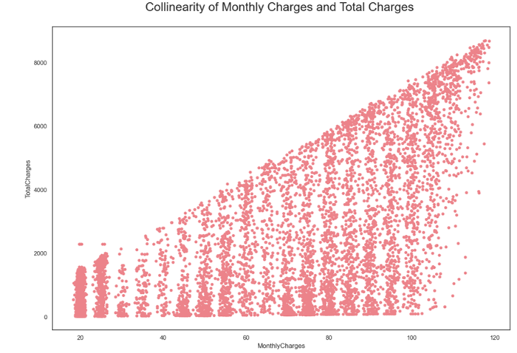
Collinearity of Features

Slide 26
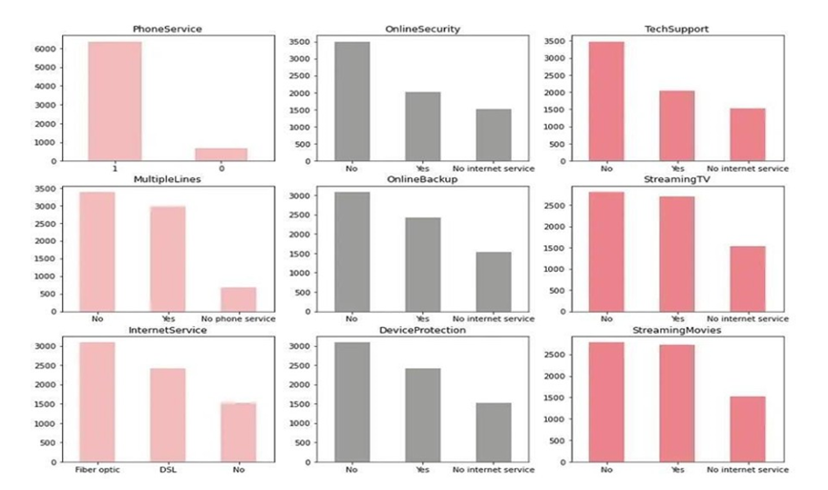
Distribution of Encoded Labels

Slide 27
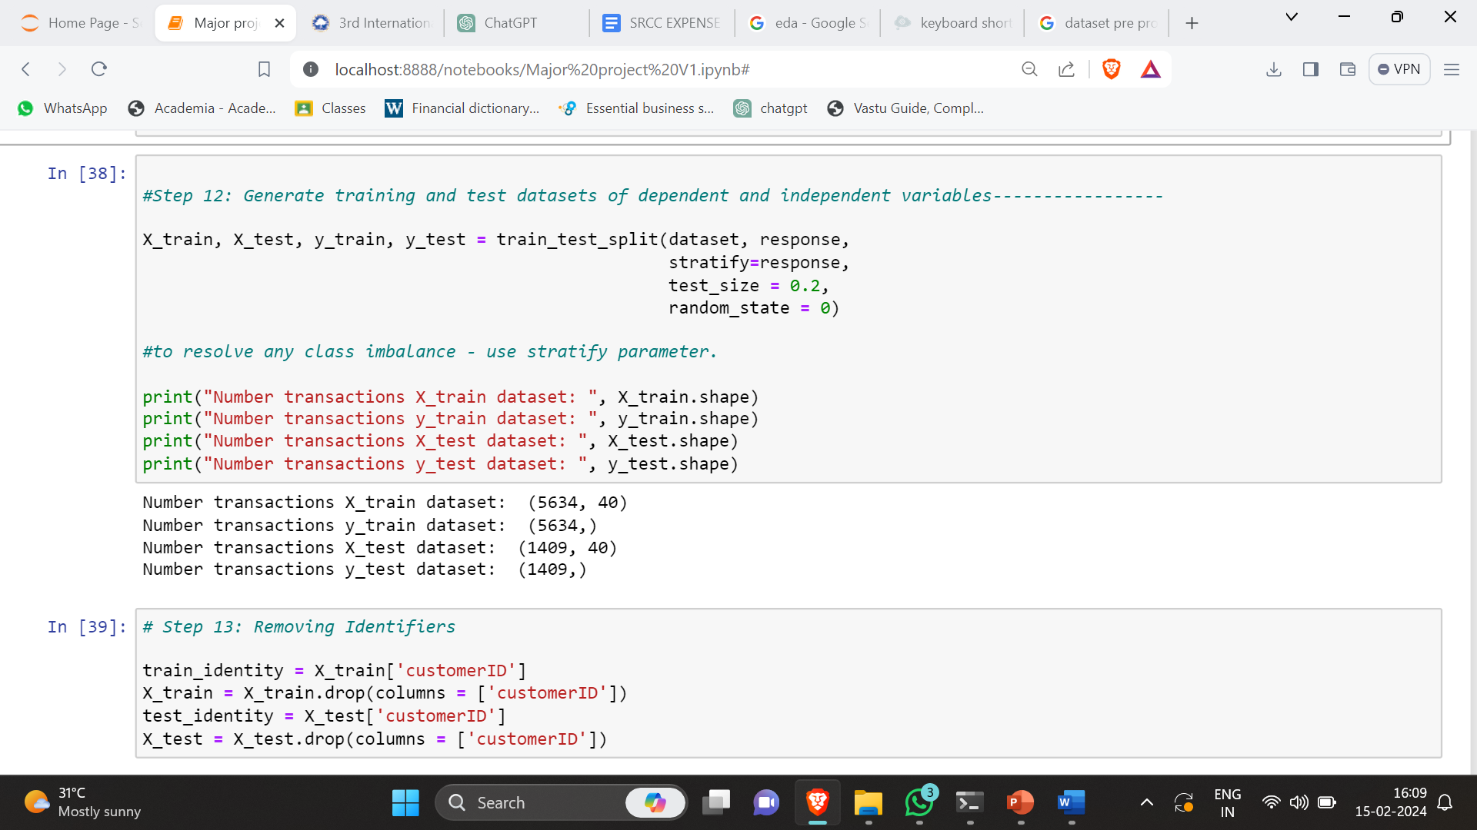
TRAINING AND TESTING SET

Slide 28
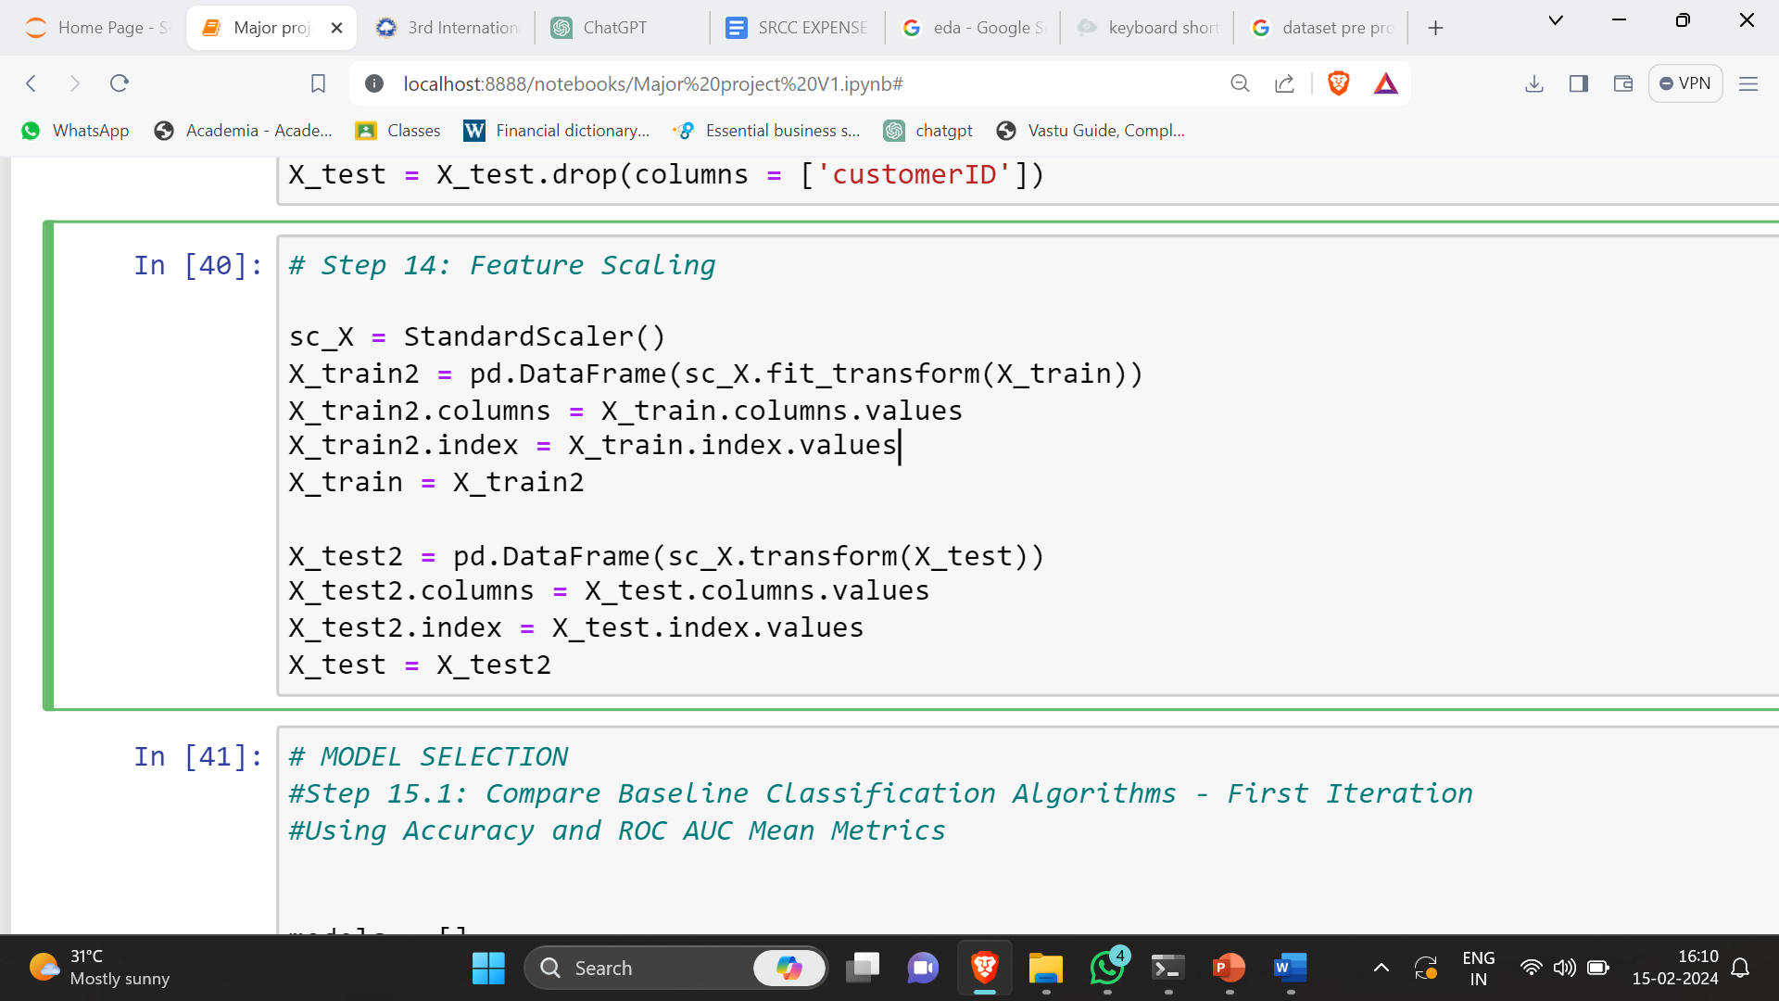
Feature Selection and Scaling

Slide 29
Module Description
Data Collection Process: The first stage is the careful collection of customer information covering a range of topics, including demographics, previous transactions, and customer interactions. Dataset from Kaggle is used, that represents a telecom service provider for our example. This methodical approach to gathering data centers on formulating a research question or hypothesis, choosing a representative sample, and choosing the right instruments and techniques for gathering data.
Data Preprocessing Steps: After the data is gathered, it undergoes extensive preprocessing. This means dealing with outliers, fixing inconsistencies, and addressing missing values. To make the data suitable for use in machine learning algorithms, it must be transformed and normalized. Data preprocessing is an extensive process with multiple components:

Slide 30
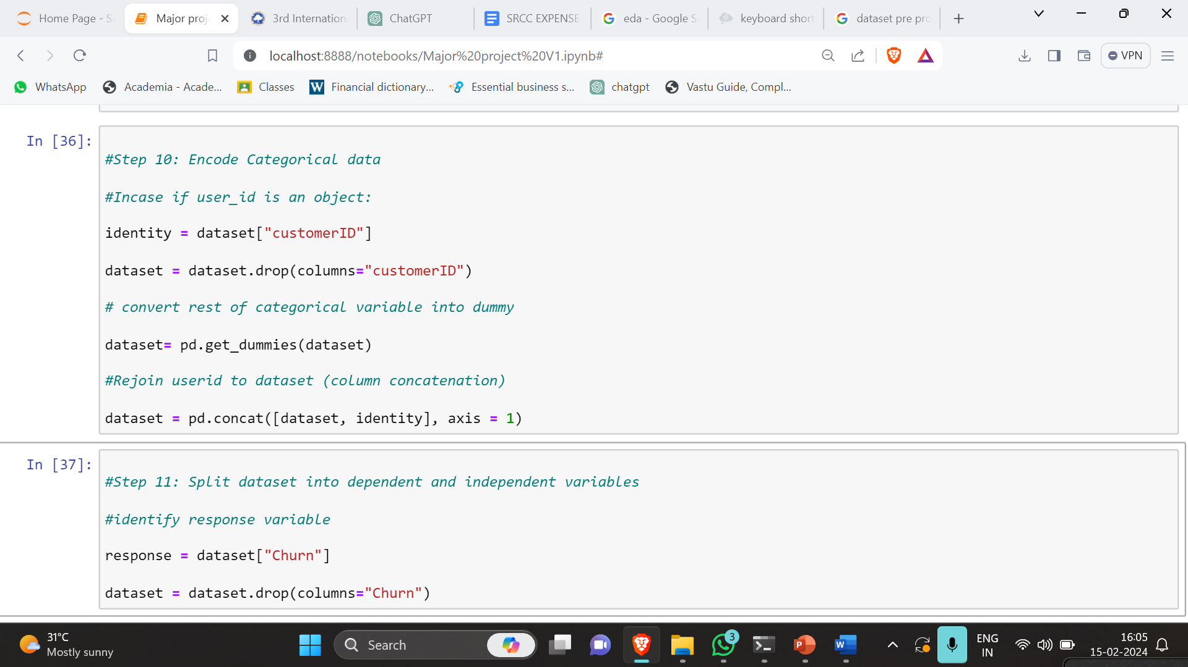
Data Pre-processing Steps

Slide 31
Data Pre-Processing Module
Data Cleaning: removing or correcting data that is erroneous, unnecessary, or incomplete.
Data Transformation: Changing the format of data involves scaling numerical attributes within a range and converting variables with categories to numerical values.
Data Normalization: Scaling data values to achieve a consistent range.
Data Discretization: dividing up continuous data into distinct groups.

Slide 32
Model Selection Module
Model Selection : Selecting an appropriate machine learning model for the particular issue at hand is a crucial decision.
Several models are used for churn prediction, including logistic regression, decision trees, random forests, and support vector machines. A critical stage in the process is selecting the best model from a pool of candidates that have all been trained on the same dataset.
Finding the model that can produce accurate predictions and generalize well to new data is the goal. Techniques for selecting models include holdout validation, bootstrapping, cross-validation, and more. The importance of careful selection is highlighted by the significant influence of model choice on predictive performance.

Slide 33
Model Description
In our study, LR is used to estimate the probability of churn based on customer features. Kernel Support Vector Machine (SVM)is an extension of the support vector machine that uses a nonlinear mapping to transform the original training data into a higher dimension. In this space, a linear separator is then constructed. With kernel SVM, we tackle the non-linear relationships between customer attributes and churn, enhancing the model's prediction capability. Random Forest (RF)is an ensemble learning method for classification, regression, and other tasks that operates by constructing a multitude of decision trees at training time. For classification tasks, the output of the random forest is the mode of the classes output by individual trees. RF contributes to the robustness of our predictive model by addressing the variance in predictions.

Slide 34
Model Description
K-Nearest Neighbors (KNN)is a non-parametric method used for classification and regression. In both cases, the input consists of the k closest training examples in the feature space. KNN is included in our approach to incorporate the principle of similarity, where the churn status of similar customers is used to predict the churn likelihood of a new customer. Decision Tree algorithm is a decision support tool that uses a tree-like model of decisions and their possible consequences. It is one way to display an algorithm that only contains conditional control statements. Decision trees help in breaking down a complex decision-making process into more manageable parts, making the model's predictions more interpretable. These models were selected for their diverse approaches to capture various aspects of customer behavior and attributes. By integrating and comparing these models, we aim to harness their collective predictive power for a more accurate and comprehensive churn prediction system.

Slide 35
Model Training
Model Training: The selected model is trained using the preprocessed data. Model training, or teaching the model to make accurate predictions, is an essential part of machine learning.
The training procedure makes use of a training dataset that contains input feature pairs and matching target labels. The model optimizes its parameters to enable accurate predictions on unseen data based on this data.
Training performance is influenced by the hyperparameters, the algorithm, the optimisation techniques, and the quality of the data.
By assessing the model's performance with validation techniques like cross-validation, accurate predictions can be guaranteed.

Slide 36
Model Evaluation
Model Evaluation: A few examples of suitable assessment metrics that are used to assess the performance of the trained model are recall, accuracy, precision, and F1 score. Model assessment, or gauging a trained model's performance on new, untested data, is an essential component of machine learning.
The aim is to confirm that the model can produce accurate predictions and generalize well. Evaluation criteria like accuracy, precision, recall, and F1 score are used, depending on the kind of application.

Slide 37
Model Deployment and Integration
Model Deployment and Integration
A model is prepared for deployment in a production environment after it has been trained and assessed. The learned model must be integrated into an end-user-accessible system or application as part of this deployment process. In the deployment environment, performance, reliability, and security optimization might be required.
This entails merging the model with the application's codebase and transforming it into a format that works with the deployment environment. Sustaining accuracy and efficacy requires constant observation and updating.

Slide 38
Future Predictions
Unpredictability and risk are inherent characteristics that are closely associated with predictive algorithms. Hence, in practical scenarios, it is advisable to construct a propensity score in addition to an absolute projected outcome. Rather of solely obtaining a binary predicted goal outcome (0 or 1), it is suggested that each 'Customer ID' be assigned an additional propensity score, which would indicate the percentage of probability associated with initiating the target action. Using propensity score we divide the customers into two categories,
High-risk for churning category and low-risk for churning category as shown in table 3 and table 4.
Index | customerID | Churn | predictions | propensity_to_churn(%) | Ranking
5532 | 9300-AGZNL I | 1 | 1 | 85.99 | 1
5173 | 5567-WSELE I | 1 | 1 | 84.87 | 1
7010 | 1415-YFWLT I | 1 | 1 | 83.25 | 1
6507 | 2446-BEGGB I | 1 | 1 | 83.22 | 1
5985 | 5277-ZLOOR I | 1 | 1 | 83.08 | 1
5636 | 8884-ADFVN I | 1 | 1 | 82.44 | 1
6667 | 6630-UJZMY I | 1 | 1 | 82.38 | 1
6501 | 2865-TCHJW I | 1 | 1 | 82.22 | 1
2367 | 4750-ZRXIU I | 1 | 1 | 82.2 | 1
1018 | 2660-EMUB I | 1 | 1 | 81.8 | 1
Category – Highest Risk For Churn

Slide 39
Future Predictions
Index | customerID | Churn | predictions | propensity_to_churn(%) | Ranking
5532 | 4957 - SREEC | 0 | 0 | 0.43 | 10
5173 | 1403 - GYAFC | 0 | 0 | 0.44 | 10
7010 | 1052 - QJIBV | 0 | 0 | 0.46 | 10
6507 | 8590 - YFFQO | 0 | 0 | 0.47 | 10
5985 | 5787 - KXGIY | 0 | 0 | 0.48 | 10
5636 | 0464 - WJTKO | 0 | 0 | 0.49 | 10
6667 | 7876 - DNYAP | 0 | 0 | 0.5 | 10
6501 | 3642 - BYHDO | 0 | 0 | 0.5 | 10
2367 | 8229 - BUJHX | 0 | 0 | 0.51 | 10
1018 | 3678- MNGZX | 0 | 0 | 0.52 | 10
Category – Lowest Risk For Churn

Slide 40
Conclusion
In the current highly competitive telecommunications industry, churn prediction is a crucial concern for customer relationship management (CRM). Its purpose is to retain valuable customers by identifying groups of customers with similar characteristics and offering them competitive offers and services. Classification accuracy is a quantitative measure used to assess the efficiency of classification methods. This measure is often used for assessing basic classification methods. However, when there are significant differences in social classes, this statistic becomes less useful. The algorithms and their corresponding accuracy are compared in Table 1. The first round of classification showed that the LRM is superior than the other five model.

Slide 41
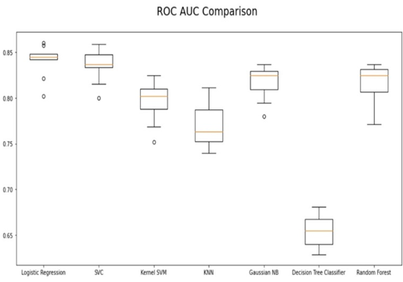
Conclusion
Figure 5. ROC AUC Comparison between algorithms
Upon examining graphical representation of the Accuracy ratings in Figure 5, it becomes evident that logistic regression outperforms the other approaches in terms of accuracy. Overall, the models perform effectively, and logistic regression demonstrated the highest utility in this particular case. As a result, efforts to develop this model have been concentrated, and the accuracy has increased. In this work, a customer churn-over model for data analytics is presented and then assessed using standard evaluation metrics. The results obtained show that our suggested churn model performs better thanks to the application of machine learning methods. With an ROC AUC mean of 88%, Logistic regression produced a better result. After analyzing the dataset, we determined the primary factors that contribute to customer churn. We next conducted cluster profiling based on the level of risk associated with each element. Ultimately, we furnished decision-makers of telecom corporations with explicit instructions on customer retention. In the future, the study might be expanded to investigate the evolving behavioral patterns of churn consumers with the application of Artificial Intelligence approaches for predictive and trend analysis. So, we conclude that we made use of a customer churn dataset from Kaggle to build a machine learning classifier that predicts the propensity of any customer to churn in months to come with a reasonable accuracy score of 80% to 84%.

Slide 42
References
Nyoman Mahayasa Adiputra, Paweena Wanchai, “Customer Churn Prediction Using Weight Average Ensemble Machine Learning Model,” 2023 20th International Joint Conference on Computer Science and Software Engineering (JCSSE).
Diaa Azzam, Manar Hamed, Nora Kasiem, Yomna Eid, Walaa Medhat,” Customer Churn Prediction Using Apriori Algorithm and Ensemble Learning,” 2023 5th Novel Intelligent and Leading Emerging Sciences Conference (NILES).
Yunjie Lin, Mu Shengdong, Gu jijian, Nadia Nedjah, “Intelligent prediction using customer churn with a Fused attentional Deep learning model,” 2022 Multidisciplinary Digital Publishing Institute(MDPI),China.
Parth Pulkundwar, Krishna Rudani, Omkar Rane, Chintan Shah, Shyamal Virnodkar, “A Comparison of Machine Learning Algorithms for Customer Churn Prediction” 2023 6th International Conference on Advances in Science and Technology (ICAST).
Eunjo Lee, Boram Kim, Sungwook, Kang, Byungsoo Kang, Yoonjae Jang, and Huy Kang Kim,”Profit Optimizing Churn Prediction For Long Term Loyal Customers in Online Games,” 2020 IEEE Transactions on Games.
Xin Hu, Yanfei Yang, Lanhua Chen , Siru Zhu, “Research on a customer Churn Combination Prediction Model Based on Decision Tree and Neural Network,” 2020 IEEE 5th International Conference on Cloud Computing and Big Data Analytics (ICCCBDA).
Harish A S, Malathy C, “Evaluative study of cluster based customer churn prediction against conventional RFM based churn model”, 2023 Second International Conference on Electrical, Electronics, Information and Communication Technologies (ICEEICT).

Slide 43
References
Kiran Deep Singh, Prabh Deep Singh, Ankit Bansal, Gaganpreet Kaur, Vikas Khullar, Vikas Tripathi, “Exploratory Data Analysis and Customer Churn Prediction for the Telecommunication Industry,” 2023 3rd International Conference on Advances in Computing, Communication, Embedded and Secure Systems (ACCESS).
Mustafa Büyükkeçeci, Mehmet Cudi Okur, “A Data Mining Application in Customer Churn Prediction,” 2022 IEEE Conference.
S. Venkatesh, M. Jeyakarthic, “An Optimal Genetic Algorithm with Support Vector Machine for Cloud Based Customer Churn Prediction,” 2020 IEEE Conference.
Aishwarya H M, Bindhiya T, S Tanisha, Soundarya B, C Christlin Shanuja, “Customer Churn Prediction Using Synthetic Minority Oversampling Technique,” 2023 4th International Conference on Communication, Computing and Industry 6.0 (C216).
Abhishek Gaur, Ratnesh Dubey, “Predicting Customer Churn Prediction In Telecom Sector Using Various Machine Learning Techniques,” 2018 International Conference on Advanced Computation and Telecommunication (ICACAT).
Mohamed Galal, Sherine Rady, Mostafa Aref, "Enhancing Customer Churn Prediction in Digital Banking using Ensemble Modeling,” 2022 4th Novel Intelligent and Leading Emerging Sciences Conference (NILES).

Slide 44
References
Fulu Chen, Xiaowei Wei, Saisai Yu, Pengfei Ma, Shuqing He, "Customer Churn Prediction based on Stacking Model,” 2023 4th International Conference on Computer Vision, Image and Deep Learning (CVIDL).
O. Rezaeian, S. S. Haghighi and J. Shahrabi, "Customer Churn Prediction Using Data Mining Techniques for an Iranian Payment Application," 2021 12th International Conference on Information and Knowledge Technology (IKT), Babol, Iran, Islamic Republic, 2021.
A. Larasati, D. Ramadhanti, Y. W. Chen, A. Muid, "Optimizing Deep Learning ANN Model to Predict Customer Churn," 2021 7th International Conference on Electronics Engineering (ICEEIE), Malang, Indonesia, 2021.
Priya Gopal, Nazri Bin MohdNawi, “A Survey on Customer Churn Prediction using Machine Learning and data mining Techniques in E-commerce,” 2021 IEEE Asia-Pacific Conference on Computer Science and Data Engineering (CSDE).
M. Ali, A. U. Rehman and S. Hafeez, "Prediction of Churning Behavior of Customers in Telecom Sector Using Supervised Learning Techniques," 2018 IEEE 3rd International Conference on Computing, Communication and Security (ICCCS) Nepal.
I. M. M. Mitkees, S. M. Badr and A. I. B. ElSeddawy, "Customer churn prediction model using data mining techniques," 2017 13th International Computer Engineering Conference (ICENCO), Cairo, Egypt
Yuwadi Thein Naing, Mafas Raheem, Nowshath K Batcha,” Feature Selection for Customer Churn Prediction: A Review on the Methods & Techniques applied in the Telecom Industry,” 2022 IEEE International Conference on Distributed Computing and Electrical Circuits and Electronics (ICDCECE).

Slide 45
Thank you!!!
Suggestions!!!

